Slide 1
GYGA Weather Data Sources in Sub-Saharan Africa

Slide 2
Weather data used for simulations
First choice: Observed, high quality, 10+ years
  Tmin, Tmax, solar radiation, relative humidity, precipitation
Acceptable: Observed, 3+ years of Tmin, Tmax
  Missing data estimated by “propagation” (see detailed explanation in the next slides)
Last resort: gridded data (NASA-POWER Agro-Climatic Data)

Slide 3
Weather data used for simulations (cont.)
The majority of the observed weather data was provided by country agronomists (CA).
Simulations were based on all available observed data and, if there was not enough data, propagated data to supplement the observed data and reach an acceptable number of years
If observed weather data were not available at all, we used crude weather data from NASA for the simulations
Because we were not allowed to make observed data provided by CA publicly available, weather data posted in the GYGA website contains only propagated data (being calibrated using the observed data provided by CA) or crude NASA data for those locations for which weather data did not exist.

Slide 4
Justification for propagated weather data
A robust estimation of average yield potential using crop simulation models requires long-term daily weather data (15+ yrs)
However, in many regions of the world, only few years of measured weather data (and for a limited number of variables) are available
Even if observed weather data are available (and can be used for simulations), the underpinning data can be rarely made publicly available
How can we use a few years of weather data to ‘generate’ suitable long-term weather records for crop simulations and/or to generate weather files that can be made publicly available?

Slide 5
Summary of a the comparison between NASA and observed daily weather data
Red dashed line: 1-to-1 line; solid black line: linear regression. Note that dots do not represent actual data!
Good agreement
Good correlation
Poor agreement
Good correlation
Poor agreement
Poor correlation
Measured weather data
R²>0.82
ME: -1.0 to 1.1 MJ
R²>0.82
ME= -3 to +2ºC
R²<0.65 (RH) & 0.25 (rain)
NASA Solar radiation
NASA Tmax, Tmin
NASA relative humidity, rain
‘Crude’ NASA radiation can be used for simulations, except at sites with complex topography
Good correlation between NASA vs. measured Tmax & Tmin but poor agreement. NASA temperature can be used for simulations after calibration against few years of measured data
Very poor agreement and correlation between NASA vs. measured relative humidity and precipitation

Slide 6
TRMM versus observed 15-day total precipitation
Red dashed line: 1-to-1 line; solid black line: linear regression.
TRMM 15-d total precipitation and occurrence of wet/dry days are in reasonable agreement with observed precipitation data making TRMM a viable alternative for crop model simulations when observed precipitation data are not available

Slide 7
Propagation of long-term daily weather data
Crude solar radiation from NASA-POWER
Calibrated-NASA Tmax and Tmin based on correlations between NASA and ground-measured Tmax and Tmin for a few number of years
Humidity is derived from crude NASA Tdew (unless measured Tdew or RH are available)
Crude TRMM rainfall data

Slide 8
Testing propagated weather data
By the end of the day, we want to see how well simulated yields based on propagated weather compare against simulations based on measured weather data
In practice, we won’t know a priori which subset of years of measured weather data will be available for calibrating NASA Tmax and Tmin.
To evaluate the sensitivity to ‘year effect’, we calibrated NASA Tmax and Tmin based on all possible subsets of 3 consecutive years of measured Tmax and Tmin. This yielded into multiple files of propagated weather data and multiple simulated average yields.
The distribution of average simulated yields based on propagated weather data was compared against the (single) average simulated yield based on long-term measured weather data
In the comparison, we also included the average yield simulated using crude NASA, crude NASA + TRMM rain, and generated weather data derived from monthly means using MarkSim
  The comparison was performed for 18 locations (including sites in South and North America, Europe, Africa, and Asia) using well-validated models based on site-specific management practices and soil type.

Slide 9
Simulations of yield potential based on propagated versus observed and gridded weather data
(M) Maize
(W) Wheat
(R) Rice
MarkSim weather generator
NASA-POWER data
Propagated weather data *
OWD: Observed weather data
Average long-term simulated yield based on observed weather data
* Each box plot represents the distribution of long-term average simulated yields based on the propagated weather files generated based on all possible subsets of 3 years of observed weather data used to calibrate NASA Tmax and Tmin

Slide 10
Conclusions
Distribution of simulated yields based on propagated weather was within (or very close to) ± 10% of the simulated yield based on measured weather in 83% of the cases
Simulations based on propagated weather had better agreement with simulations based on measured weather than other sources of weather data (such as crude NASA or weather generators)
Wherever only few years of measured Tmax & Tmin data are available, the propagation technique is a viable and superior alternative to generate long-term weather for crop simulations.

Slide 11
Conclusions (cont.)
After phase-1, GYGA has one of the most complete, site-specific, weather database for Sub-Sahara Africa
Simulations were based on all available observed data (provided by country agronomists), and, if there was not enough data, propagated data to supplement the observed data and reach an acceptable number of years
Because we are not allowed to post observed data provided by country agronomists, weather data posted in the GYGA website contains only propagated data (being calibrated using the observed data provided by CA) or crude NASA data for those locations for which weather data did not exist.
Different types of weather data will be distinguished by colour coding – SEE NEXT SLIDE

Slide 12
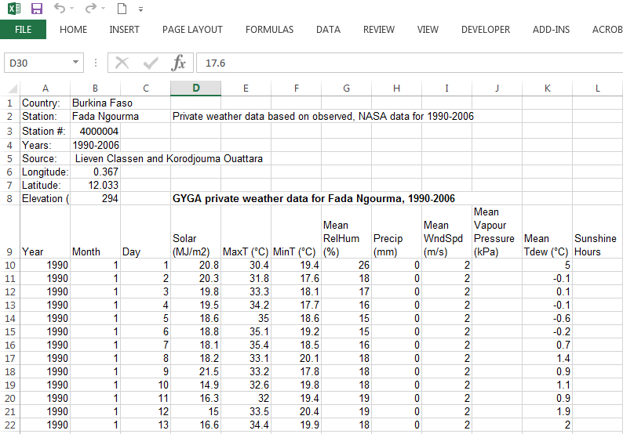
Observed data

Slide 13
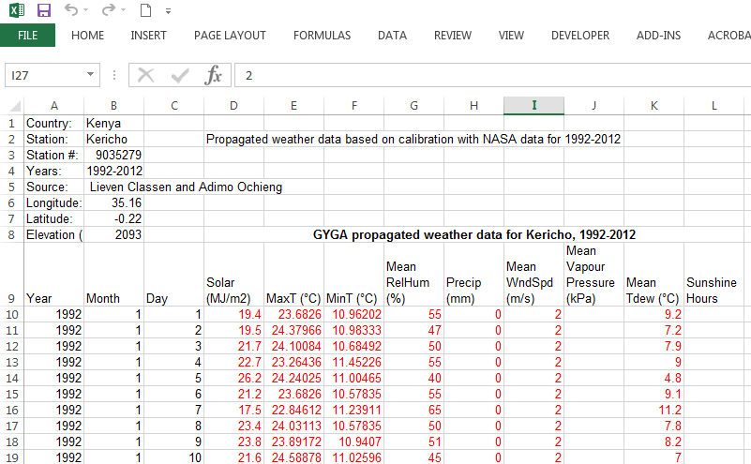
Propagated data

Slide 14
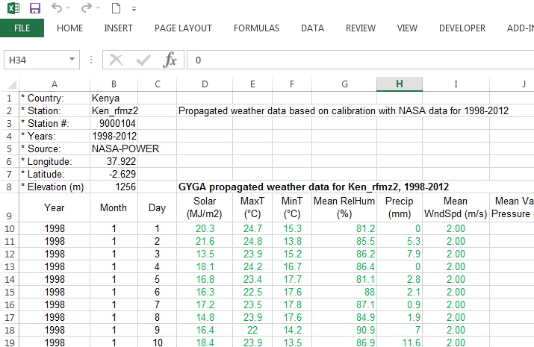
Crude data from NASA

Slide 15
References
Van Wart J, Grassini P, Yang HS, Claessens L, Jarvis A, Cassman KG, 2015. Creating long-term weather data from thin air for crop simulation modelling. Agricultural and Forest Meteorology 208, 49-58.

